Slide 1
Unveiling Phishing Patterns through Machine Learning
Paulina Gonzalez (V01045753)
Jharna kumari (V01046956)
Jheel Chirag Shah (V01033440)
Adel Agha (V01046273)
Birva Patel (V01046694)
Bilel Matmti (V00947293)
Zixin Li (V01046098)
Summer Liu (V00911652)

Slide 2
Introduction to the Dataset
The dataset contains 2,576 entries with four columns, each representing a message
Raw Data: Needed to be preprocessed and cleaned before being used for analysis or modeling
Data Preprocessing
Dropping Unnecessary Columns
Handling Missing Values
Normalizing Text Data

Slide 3
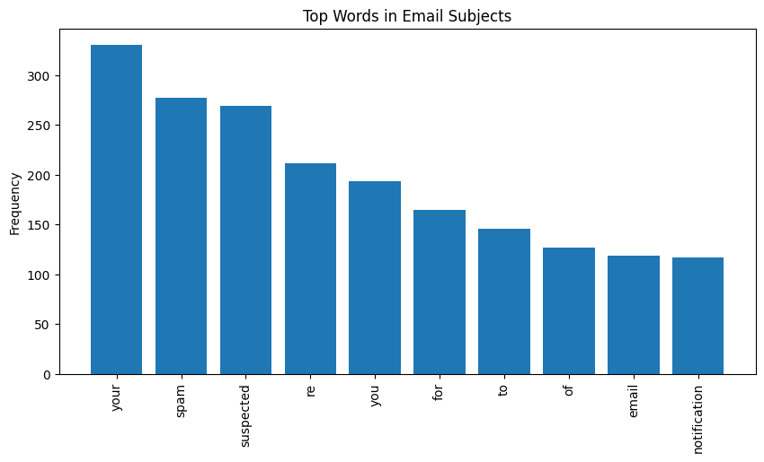
Data Visualization

Slide 4
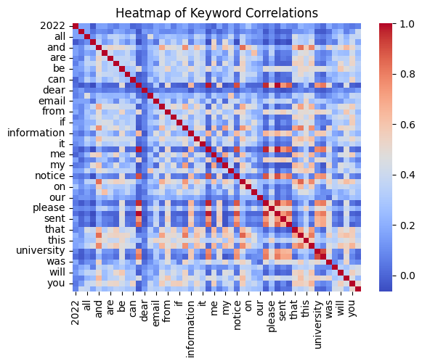
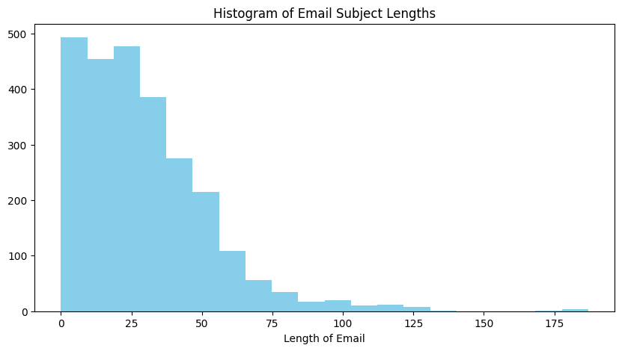
Data Visualization

Slide 5
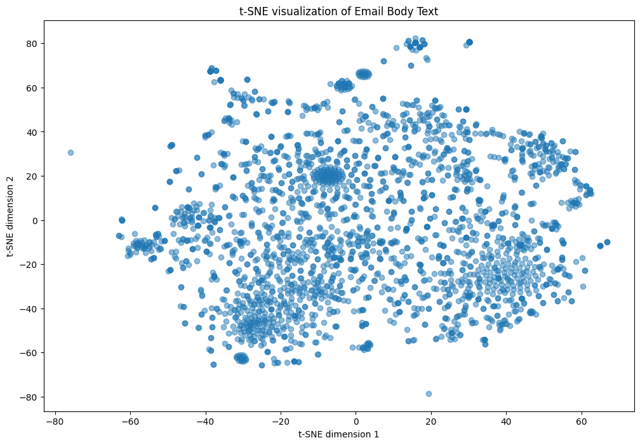
Data Visualization
t-SNE

Slide 6
K-Means
What is K-Means Clustering?
Definition: A popular unsupervised machine learning algorithm used to divide a set of data points into distinct groups (clusters), based on similarity.
Objective: Minimize the variance within each cluster and maximize the variance between clusters.
How Does K-Means Work?
Step 1: Choose the number of clusters, K.
Step 2: Randomly assign K centroids.
Step 3: Assign each data point to the nearest centroid, forming K clusters.
Step 4: Recalculate centroids.
Step 5: Repeat steps 3 and 4 until centroids stabilize (convergence).
Notes:
K-means clustering is an algorithm that enables data segmentation into K distinct, non-overlapping clusters based on the features of the data points. It is an essential tool in data analysis, helping to reveal natural groupings, patterns, and insights from raw data.
Initialization: Starts by selecting K points as initial centroids randomly or based on a heuristic.
Assignment: Each data point is assigned to its nearest centroid, based on the Euclidean distance. This step forms K preliminary clusters.
Update: The centroid of each cluster is recalculated as the mean of all points assigned to the cluster. This helps in refining the cluster.
Convergence: Steps of assignment and update are repeated iteratively until the centroids no longer change, indicating that the clusters are as consistent as possible.

Slide 7
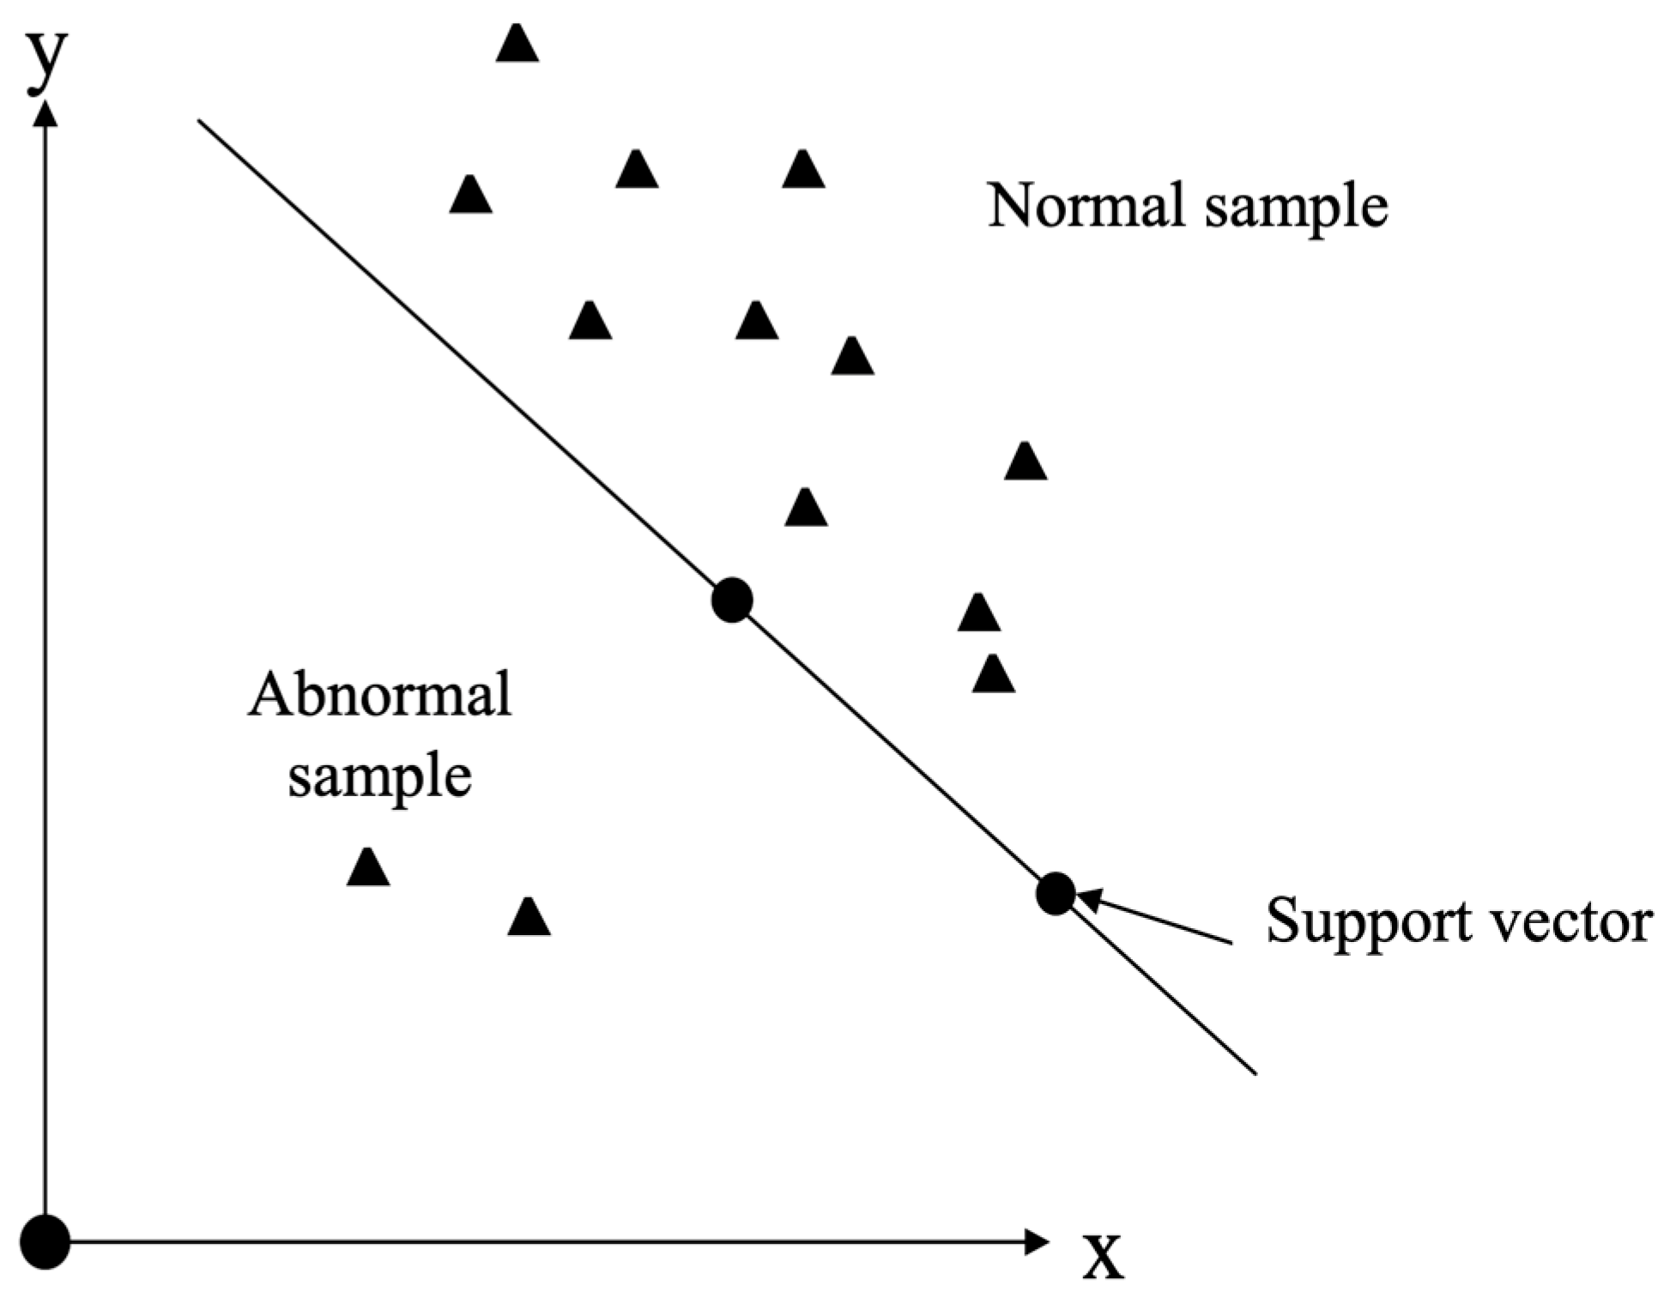
SVMs for Phishing Detection
A supervised learning algorithm used for classification and regression, known for its ability to effectively separate different classes in high-dimensional spaces.
One-Class SVM is a specialized version of SVM designed for anomaly detection, focusing on learning and distinguishing patterns of a single class to identify data points that do not conform to the norm.
Traditional SVM: Effective for labeled datasets.
One-Class SVM: Ideal for unlabeled data.
Effective in high-dimensional spaces, like email content.
Requires careful feature extraction and preprocessing.
Image Source: Huang et al. (2023) [6]

Slide 8
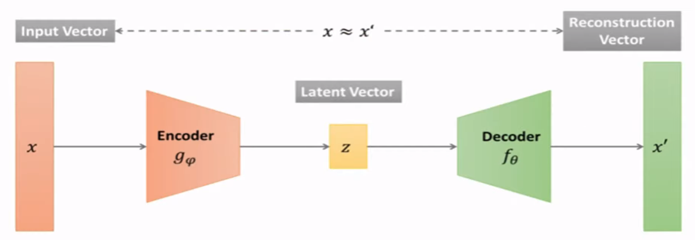
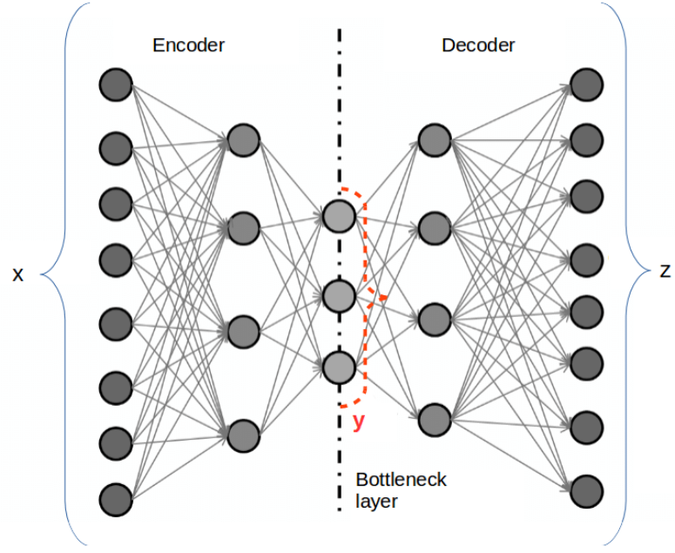
Deep Autoencoders
Powerful Deep Neural Network technique
Widely used in Cybersecurity for intrusion detection
Resembles an Identity function
Focused on feature extraction and dimensionality reduction
Goal: Detect significant deviations from the behavior of the data
Images Source: https://www.researchgate.net/figure/Deep-Autoencoder-DAE_fig2_317559243

Slide 9
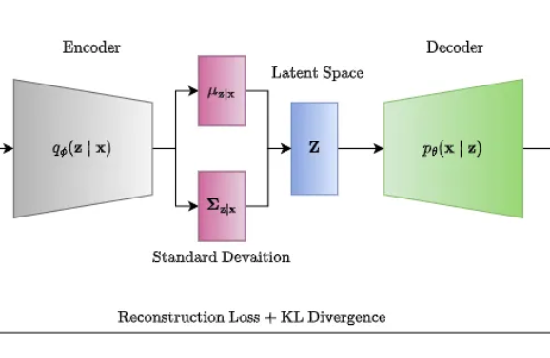
Variational Autoencoders (VAEs)
Overcomes the limitations of traditional AEs
Introduces a probabilistic framework for generating the compressed representation of the input data
Huge advantage: Allows VAEs to learn a more structured and continuous latent space representation -> Generative Modelling
Image Source: https://medium.com/@rushikesh.shende/autoencoders-variational-autoencoders-vae-and-%CE%B2-vae-ceba9998773d

Slide 10
Conclusion
Exploration:
Analyzed and visualized the dataset
Explored how 3 different ML and DL techniques can help detect phishing emails Each method offers unique strengths in identifying these activities
Future Work:
Explore more DNN techniques
Training and Implementation
Variational Autoencoders(VAEs), a probabilistic model
Generative Adversarial Networks (GANs)

Slide 11
References
[1] M. Basavaraju and Dr. R. Prabhakar, “A novel method of spam mail detection using text based clustering approach,” International Journal of Computer Applications, vol. 5, no. 4, pp. 15–25, Aug. 2010. doi:10.5120/906-1283
[2] R. Basnet, S. Mukkamala, and A. H. Sung, “Detection of phishing attacks: A machine learning approach,” Soft Computing Applications in Industry, pp. 373–383, Feb. 2008. doi:10.1007/978-3-540-77465-5_19
[3] Altaher, A. (2017). Phishing Websites Classification using Hybrid SVM and KNN Approach. International Journal of Advanced Computer Science and Applications, 8(6). Retrieved from http://thesai.org/Publications/ViewIssue?volume=8&issue=6&code=IJACSA
[4] Beaman, C.P., & Isah, H. (2022). Anomaly Detection in Emails using Machine Learning and Header Information. ArXiv, abs/2203.10408.
[5] GeeksforGeeks. (n.d.). Understanding One-Class Support Vector Machines. Retrieved from https://www.geeksforgeeks.org/understanding-one-class-support-vector-machines/
[6] Huang, G., Chen, J., & Liu, L. (2023). One-Class SVM Model-Based Tunnel Personnel Safety Detection Technology. Applied Sciences, 13(3), 1734. Image retrieved from https://www.mdpi.com/applsci/applsci-13-01734/article_deploy/html/images/applsci-13-01734-g001.png

